Slide 1
College of Veterinary Medicine
Parasitology
BY
Prof. Dr. Suzan A. Al-azizz

Slide 2
A SPECIES IS BINOMIAL
Parasitology is the study of parasites, their hosts, and the relationship between them. As a biological discipline, the scope of Parasitology is not determined by the organism or environment in question, but by their way of life. This means it forms a synthesis of other disciplines, and draws on techniques from fields such as cell biology, bioinformatics, biochemistry, molecular biology, immunology, genetics, evolution and ecology.
Before the beginning the fascinating topic of Parasitology, there tend to be one common deficiency that needs immediate remedy. Namely, the basic Linnaeus concept or rule that states that a species is binomial.

Slide 3
This is a universal in zoology, botany, Parasitology, and bacteriology, but for some reason many students have failed to grasp this concept. The Swedish scientist Carolus von Linnaeus (1707-1778) developed the binomial system of nomenclature that is still in use today. As an example, let's use the species Homo sapiens )"humans" to you molecular biologists). Homo is the genus, sapiens is the trivial name (nomentriviale or specific epithet), and together they make up the species. The epithet sapiens is NOT the species, although some very basic texts erroneously say it is. Remember... a species is binomial ("two names").

Slide 4
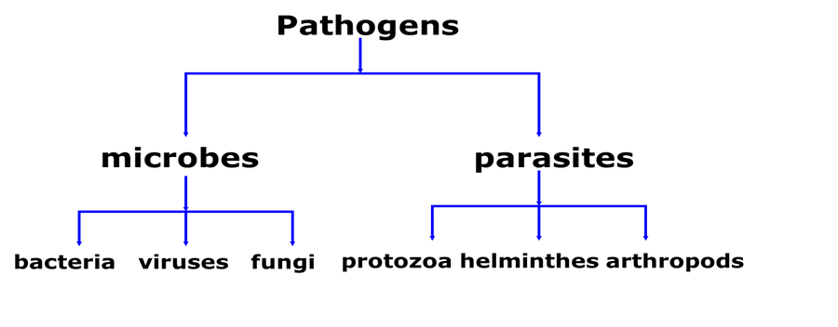
The taxonomically of pathogens classify according to the sachem below :

Slide 5
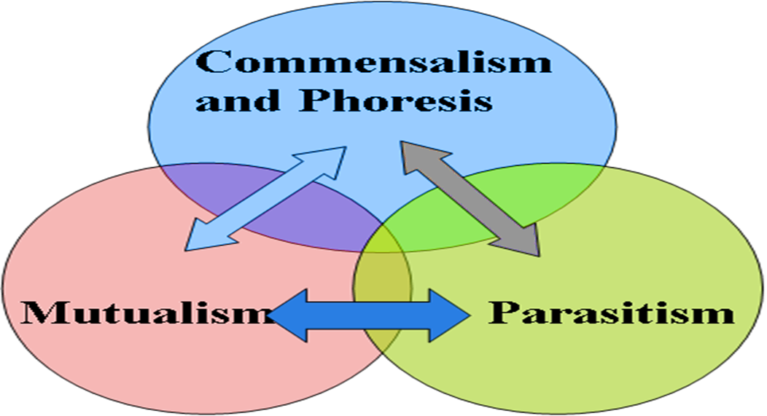
INTRODUCTION TO THE PARASITOLOGY
Medical parasitology traditionally has included the study of three major groups of animals: parasitic protozoa, parasitic helminthes (worms), and those arthropods that directly cause disease or act as vectors of various pathogens. The relationship between organisms as in the sachem below:

Slide 6
Parasitology is a type of SYMBIOSIS that living together in the plant, animal, or protest, which is intimately associated with another organism of a different species; each member is termed a SYMBIONT. There are various type of symbiosis:
A. PHORESIS is a traveling together or to carry. A smaller organism is termed a PHORONT that is carried mechanically by a HOST for instance, bacteria, fungus, cysts, or eggs on insect legs or even passively within an arthropod gut.

Slide 7
B. COMMENSALISM means when one symbiont is named a COMMENSAL, benefits and the other animal is neither helped nor harmed True commensalism is difficult to find, and may not even actually exist. Close inspections usually reveal either a mutualistic or parasitic association. Perhaps Entamoeba gingivalis in mouth to some degree; some pilot fish and remoras associated with sharks
C. MUTUALISM means each member is named MUTUALIST, depends upon the other; obligatory or facultative in nature for instance, flagellates produce cellulose in gut of termites, ciliates in ruminants, algae and fungus forming a lichen; crocodiles and Egyptian teeth cleaning plovers.

Slide 8
D. PREDATION means where one member is named a PREDATOR, benefits and a smaller organism is called a PREY that is harmed and usually eaten. This association is not usually considered a type of symbiosis, but it technically falls under the definition]. Examples include coyotes and rabbits, cats and mice.
E. PARASITISM means where one member is named a PARASITE, lives in or on another organism that is called a HOST.
However, PARASITOLOGY is the study of the relationship between a parasite and its host. This method of existence is the single most successful way of making a living, and it has been estimated that no less than 80% of all species of organisms are parasites. Parasitic relationships may be temporary, facultative, or obligatory.

Slide 9
The Basic types of parasitism and terminology:
- ECTOPARASITE: lives on surface of the host, appropriate terminology includes the terms "infected" and "infested" [i.e. ticks, lice, fleas].
- ENDOPARASITE: lives within the host, appropriate terminology is "infected;" infested is inappropriate terminology [i.e. roundworms in gut, tapeworms in gut].
- HYPERPARASITE: parasite within a parasite [i.e. malaria in mosquitoes; tapeworm larvae in fleas].

Slide 10
- VECTORS: transmits parasites from host to host, and this is divided into:
O BIOLOGICAL VECTOR: essential in life-cycle of parasite.
O MECHANICAL VECTOR: unessential in life-cycle of parasite phonetic.
Class of Parasites
1. Temporary Parasite: Visits it's host for a short period.
2. Permanent Parasite: Leads a parasitic life throughout the whole period of its life.
3. Facultative Parasite: Leaves a parasitic life when opportunity arise.
4. Obligatory Parasite: Cannot exist without a parasitic life.

Slide 11
5. Occasional or Accidental Parasite: Attacks an unusual host.
6. Wandering or Aberrant Parasite: Happens to reach a place where it can't live.
Types of Hosts:
- Definitive or Final Host : Host in which parasite reaches sexual maturity and reproduces.
- Intermediate Host: Some development in host, but does not reach sexual maturity, often asexual stages.
- Paratenic or Transport Host: No parasite development; but parasite continues to live and is infective to next host, for instance and pseudophyllidean tapeworm larvae in fish.
- Reservoir Host: Non-human animals that serve as sources of infection to humans.

Slide 12
Types of Life Cycle:
- Direct Life Cycle: Infective stage is reached in the environment.
- Indirect Life Cycle: Infective stage is reached in an intermediate host.
- INFECTION: Parasites maybe endoparasites especially protozoa that inside cells of the host.
- INFESTATION- Parasites such as worms and ectoparasites that outside cells of the host or on the host.

Slide 13
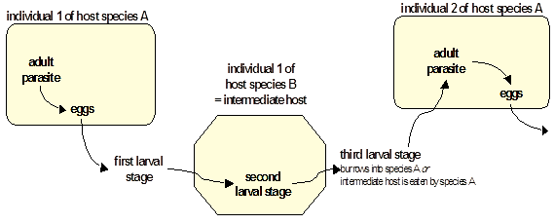
Scheme of Complex Life Cycle
Two or more host species and parasite exploits food chain relationships of hosts - increases chances of locating hosts and reduces chances of super-infecting host.

Slide 14
THANK YOU

